Slide 1
Contents
Abstract
Introduction
Literature Survey
Problems In Existing System
Proposed System
Objectives
Project Domain
Requirement Analysis
Functional Requirements
Non Functional Requirements
Software Requirements
Hardware Requirements
System Architecture
Methodology and Design

Slide 2
Contents
UML Diagrams
Class Diagrams
Statechart Diagram
Component Diagram
Deployment Diagram
Expected Deliverables
Implementation Steps
Result Analysis
Comparing Various Resumes
Attainment of Objective
Future Scope of Project

Slide 3
ABSTRACT
Job Requirement is considered one of the major activities for humans which is a very strenuous job to find fruitful talent. Agencies and various high-level firms must deal with a large number of new jobs seeking people with various resumes. However, managing large amounts of text data and selecting the best-fit candidate is more difficult and time consuming. Our model is basically to extract the details and statistics from the resume and ranking the resume based on the preference of the company associated requirements using Natural Language Processing (NLP). This project presents a system that uses Natural Language Processing (NLP) techniques to extract minute data from a resume, such as education, skills, and experience. Basically, we are going to build a job portal where the employees and applicants would upload their resume for a particular job, the information will be parsed and structured resume with information will be generated and that gives the percentage of the match and also resumes of employees will be ranked according to the requirement of the company skill set.

Slide 4
INTRODUCTION
In a competitive business environment riddled with talent shortages, hiring the right people for the right role and at the right time are doubly challenging. Developing a strong talent pipeline demands accurate matching of profiles and enhanced operational efficiency. However, most recruiters rely on manual screening and matching processes that are tedious, consuming most of their time. Additionally, traditional application tracking systems (ATS) are difficult to integrate with new technologies and increase dependence on people capabilities, hampering efficiencies and scalability.
Resume parsing refers to the automated storage, organization and analysis of job resumes. Resume parsing software provides companies an efficient way to identify keywords, skills, and so forth, in order to sort through large quantities of applications to identify the best applicants.

Slide 5
Resume parsing refers to the automated storage, organization and analysis of job resumes. Resume parsing software provides companies an efficient way to identify keywords, skills, and so forth, in order to sort through large quantities of applications to identify the best applicants.

Slide 6
LITERATURE SURVEY
Anushka Sharma , Smithi Singhal , Dhara Ajudia “Intelligent Recruitment System” ,In this paper a basic prototype has been successfully developed that not only parses and extracts appropriate particulars of the candidates, but also presents them their level of skills and ranks in the order of their similarity with their job role, thus helping the recruiters in employing the right individual from the myriad of job applications.
S Bharadwaj, Rudra Varun, Potukuchi Sreeram Aditya, Macherla Nikhil, G.Charles Babu “Resume Screening using NLP and LSTM.” The proposed project used a natural language processing toolkit to achieve high accuracy. It has a straight forward interface, So it is easy for naive users to access it.

Slide 7
OTHER APPROACHES TCS Resume parsing(neuralent)
Neuralent cost-effectively integrates with existing systems to automate and accelerate job fulfillment. The platform leverages machine learning (ML) to extract elements such as name, skills, role and experience and stores it in a secure database. It performs multi-label classification to predict the top three roles for a candidate based on skills, experience, and certifications. It also harnesses a time-series forecasting model to predict demand for various roles based on historical data. The solution digitizes jobs, services, and offerings and creates a unique recruitment identity for every job seeker. The platform’s distributed digital job repository encompassing varied clients and skill sets helps address job requirements across industries, while maintaining audit trials of candidate work experience.

Slide 8
Rchilli’s
RChilli’s resume parser API is a deep learning/AI framework that identifies complete information from resumes and enriches it through its taxonomies. The resume parser extracts candidate data from resumes in 140+ data fields through REST API. It analyses resumes created in any document format, such as DOC, DOCX, PDF, RTF, TXT, ODT, HTM and HTML, DOCM, DOTM, DOT, DOTX.

Slide 9
PROBLEMS IN EXISTING SYSTEM
Does not work on candidate side.
Implementation of both the company and candidate side may not be possible.

Slide 10
PROPOSED SYSTEM
Resume parser is an NLP model that can extract information like Skill, University, Degree, Name, Phone Designation ,Email other Social media links Nationality, etc. irrespective of their structure. To create such an NLP model that can extract various information from resume, we have to train it on a proper dataset.
A resume parsing technology converts an unstructured form of a resume data into a structured format. A Resume parser analyses resume data and extract it into machine-readable output such as XML,JSON.A CV/resume parser helps automatically store, organize, and analyse resume data to find the best candidate by ranking.

Slide 11
OBJECTIVES
The main objective of this project is to parse the resumes by converting unstructured data into structured data that makes easy to identify the skillset, goals, behavioural dimensions of an employee . It also provides a ranking system that makes to identify the best employee’s resume of all other resumes.
It provides the percentage it matches with the required qualifications of a particular company with the employee resume.

Slide 12
PROJECT DOMAIN
Natural language processing (NLP) refers to the branch of computer science — and more specifically, the branch of artificial intelligence or AI—concerned with giving computers the ability to understand text and spoken words in much the same way human beings can.
Machine learning is a branch of artificial intelligence (AI) and computer science which focuses on the use of data and algorithms to imitate the way that humans learn, gradually improving its accuracy.

Slide 13
FUNCTIONAL REQUIREMENTS
Collecting the dataset
Resume parser is an NLP model that can extract information like Skill, University, Degree, Name, Phone, Designation, Email, other Social media links, Nationality, etc. irrespective of their structure.
To create such an NLP model that can extract various information from resume, we have to train it on a proper dataset.

Slide 14
NON FUNACTIONAL REQUIREMENTS
Accuracy and Precision
Flexibility
Privacy
Maintainability
Usability
Security
Scalability

Slide 15
SOFTWARE REQUIREMENTS
Python
nltk
PostgreSQL
Elasticsearch DSL
count vectorizer
Visual studio

Slide 16
HARDWARE REQUIREMENTS
Operating System: Linux or Windows
RAM: 4GB
Graphic Card: Intel
Hard Disk: 2GB

Slide 17
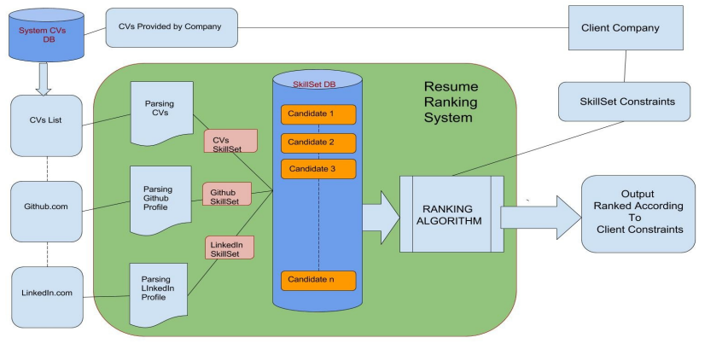
System Architecture

Slide 18
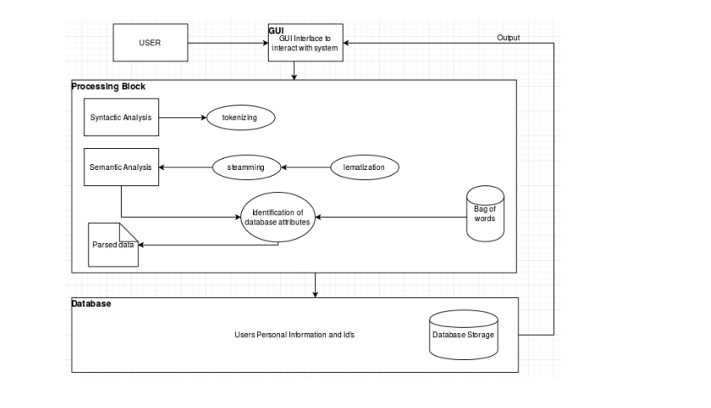
Methodology and Design

Slide 19
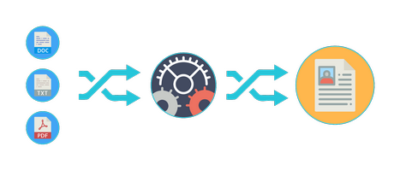

Slide 20
UML Diagrams
The Unified Modelling Language allows the software engineer to express an analysis model using the behavior notation that is governed by a set of syntactic semantic and pragmatic rules. A UML system is represented using five different views that describe the system from distinctly different perspective. Each view is defined by a set of diagrams.
User Model View: This view represents the system from the user’s perspective. ii. The analysis representation describes a usage scenario from the end-user’s perspective.
Structural view: In this model the data and functionality are arrived from inside the system. ii. This model view models the static structures.
Behavioural Model View: It represents the dynamic of behavioural as parts of the system, depicting the interactions of collection between various structural elements described in the user model and structural model view.
Implementation Model View: In this the structural and behavioural as parts of the system are represented as they are to be built.
Environmental View: In these the structural and behavioural aspects of the environment in which the system is to be implemented are represented.

Slide 21
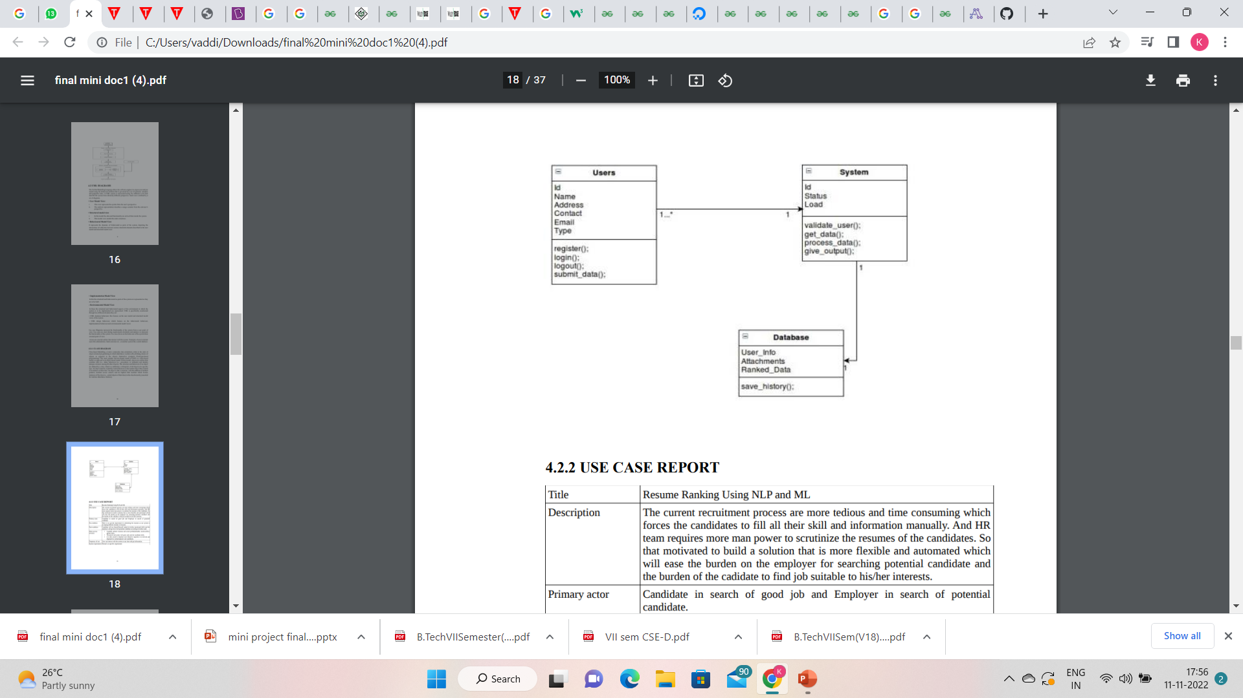
Class diagram
The structure and behaviour of an object are defined by a class, which is a definition, or blueprint, of all objects of a specific type. An object must be explicitly created based on a class and an object thus created is an instance of that class.

Slide 22
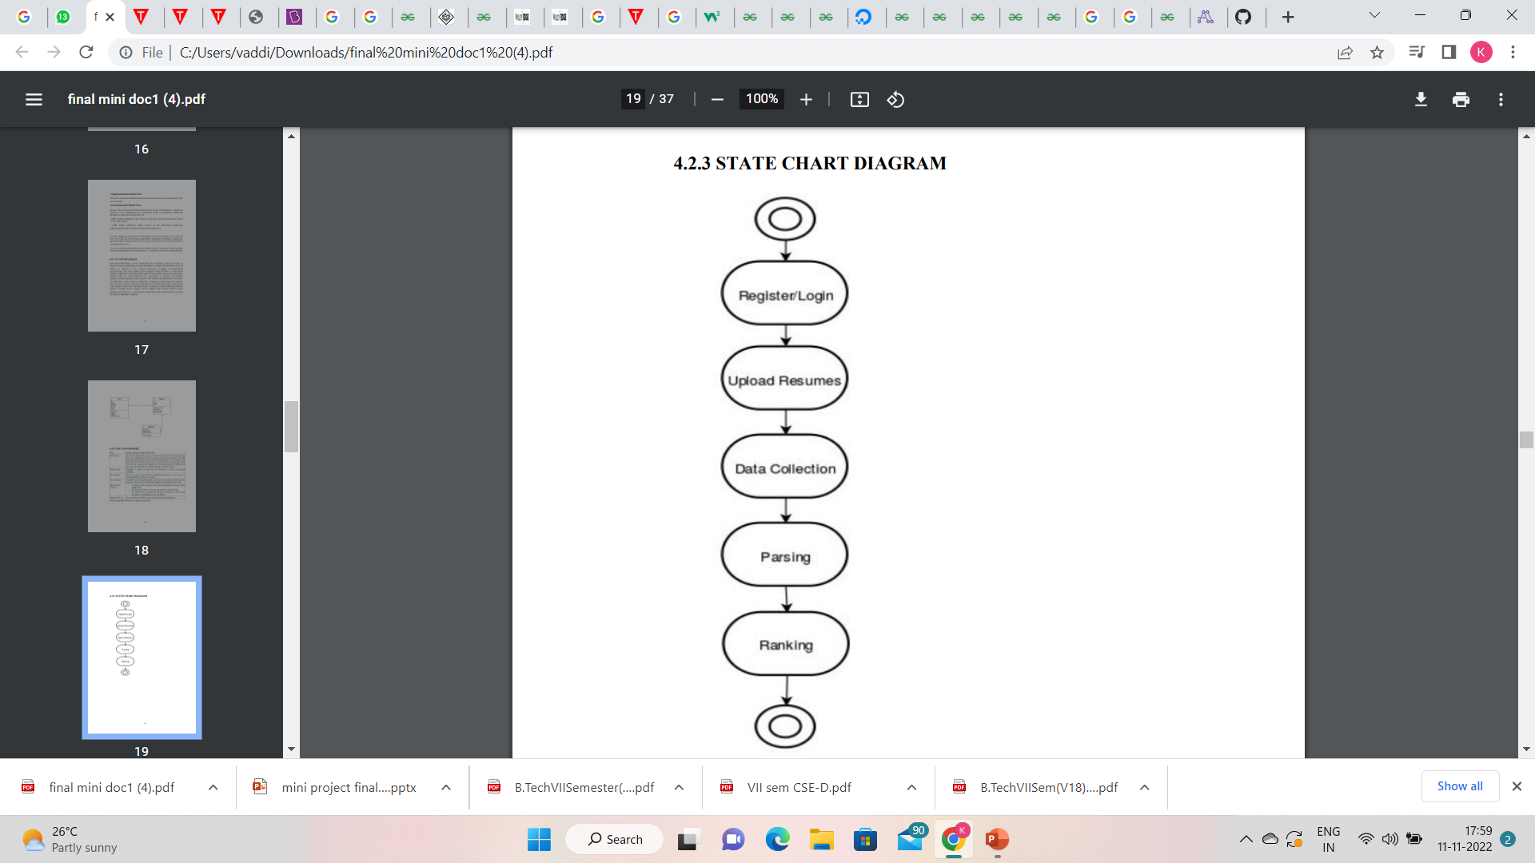
Statechart Diagram
State chart diagram is used to describe the states of different objects in its life cycle. Emphasis is placed on the state changes upon some internal or external events. These states of objects are important to analyze and implement them accurately. Statechart diagrams are very important for describing the states.

Slide 23
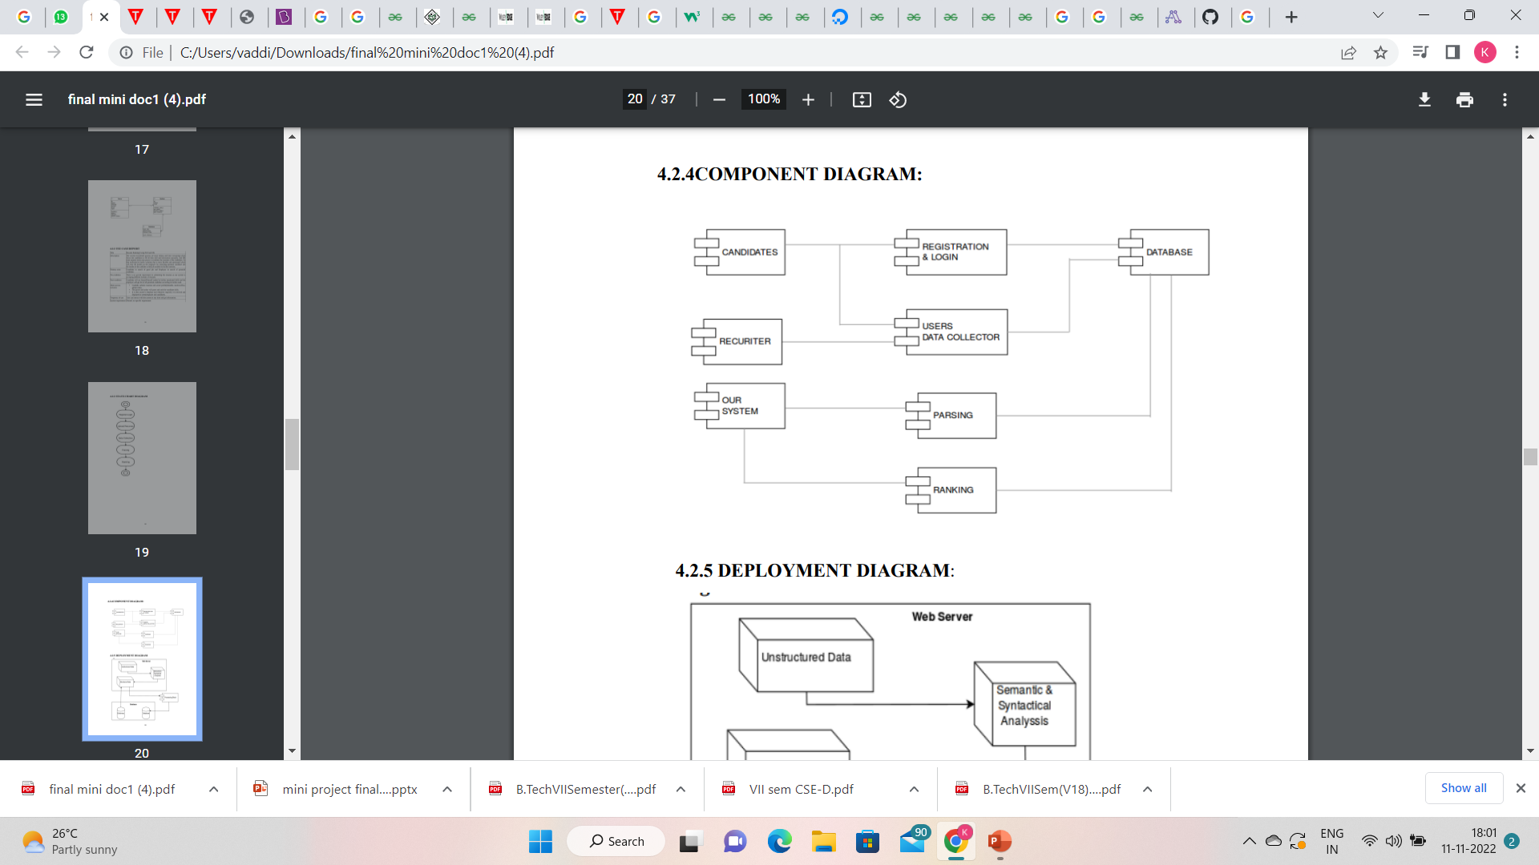
Component diagram
The purpose of a component diagram is to show the relationship between different components in a system. For the purpose of UML 2.0, the term "component" refers to a module of classes that represent independent systems or subsystems with the ability to interface with the rest of the system.

Slide 24
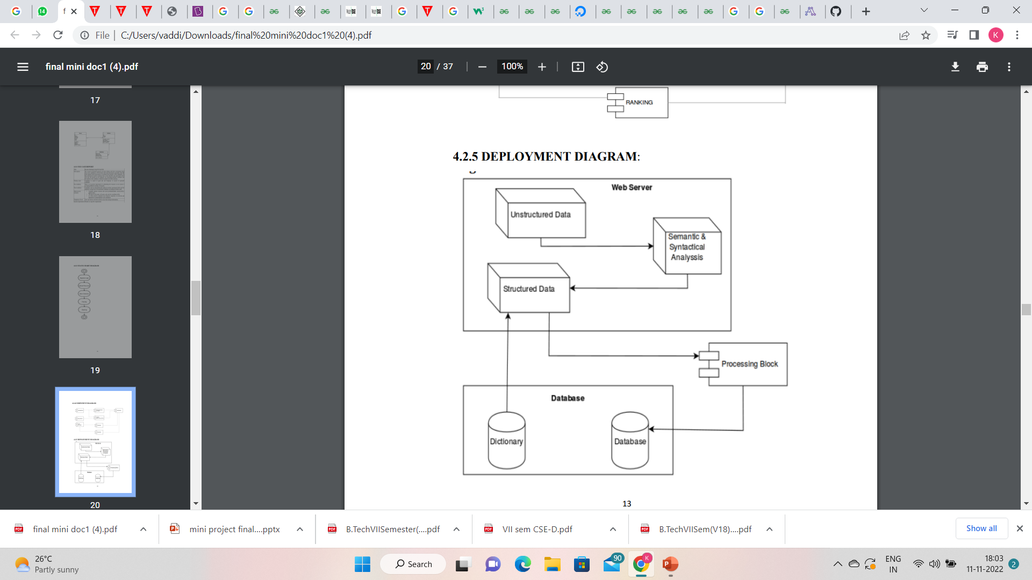
Deployment diagram
In UML, deployment diagrams model the physical architecture of a system. Deployment diagrams show the relationships between the software and hardware components in the system and the physical distribution of the processing.

Slide 25
Expected deliverables
The main objective of this project is to parse the resumes by converting unstructured data into structured data that makes easy to identify the skillset, goals, behavioural dimensions of an employee . It also provides a ranking system that makes to identify the best employee’s resume of all other resumes.
It provides the percentage it matches with the required qualifications of a particular company with the employee resume.

Slide 26
Implementation Steps

Slide 27
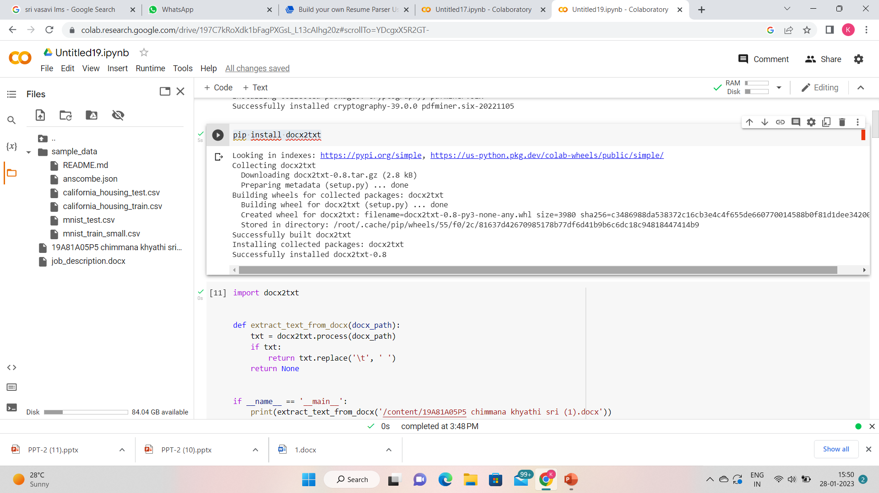
Step -1:-Installing docx2txt library ,which is a python utility to extract text and images from docx files.

Slide 28
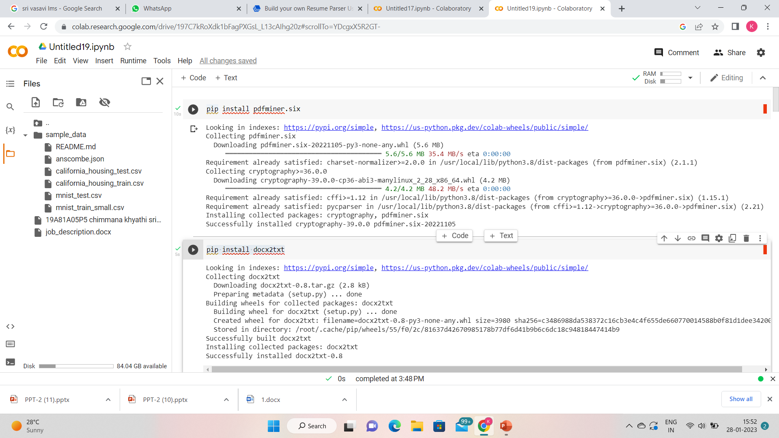
Step-2:-Installing pdfminer.six library ,which is a python utility to extract text and images from pdf files.

Slide 29
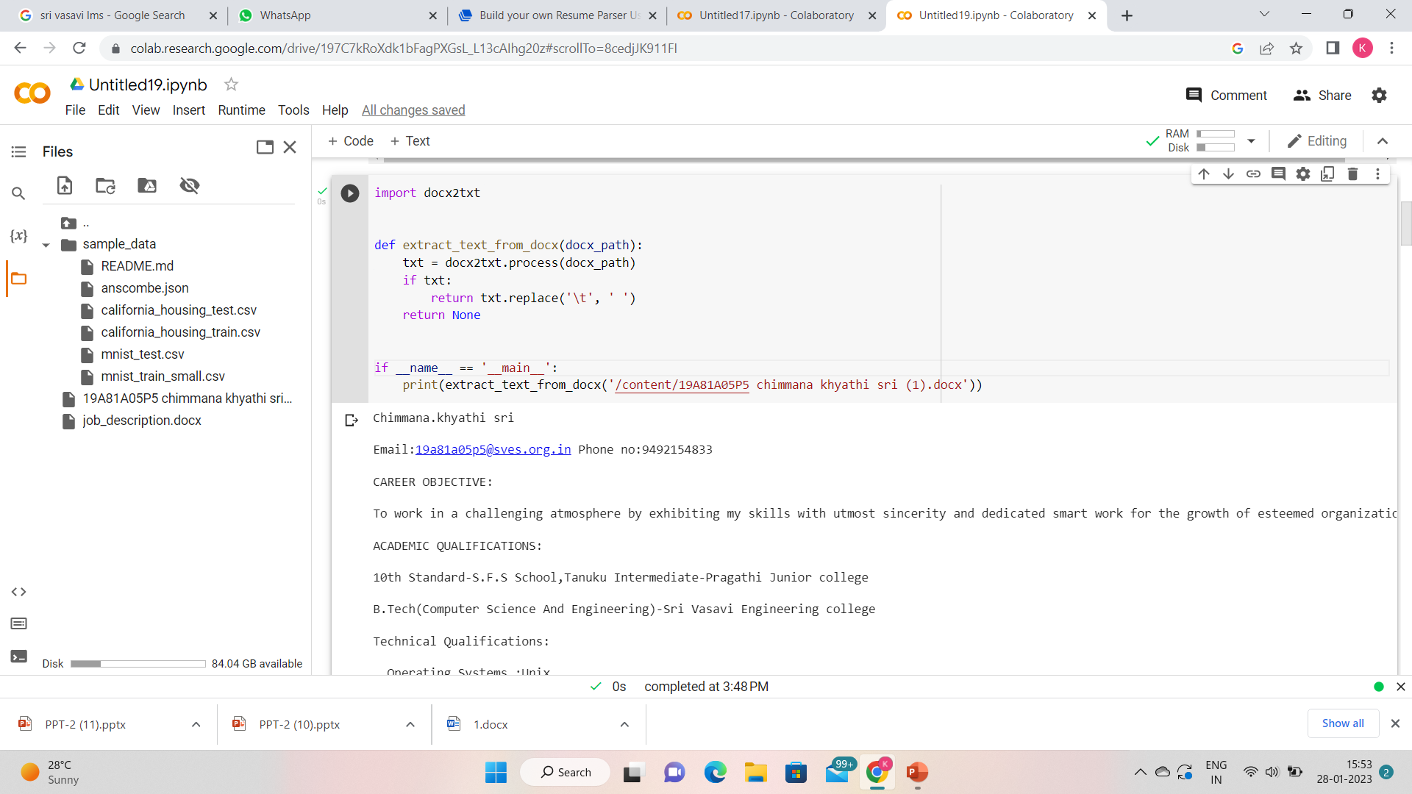
Step-3:-Extracting the text from the docx.

Slide 30
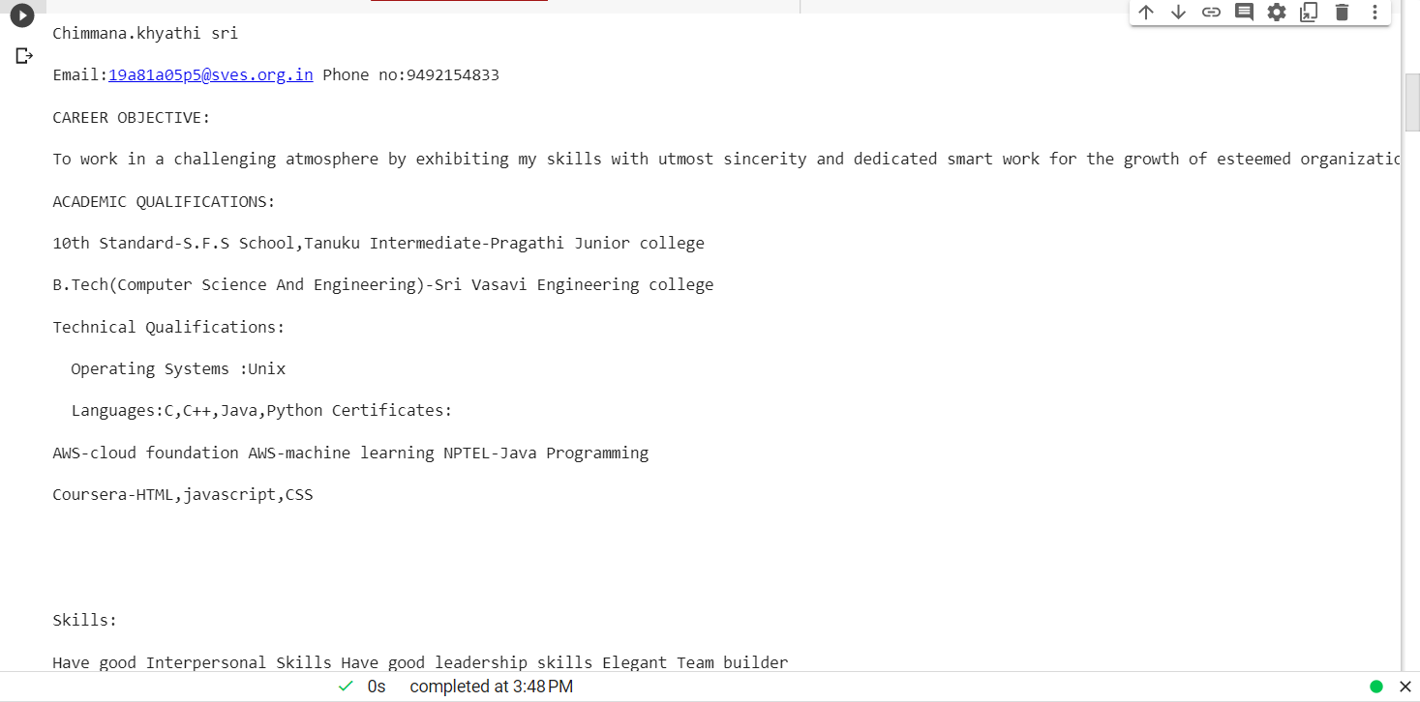
The text displayed from the docx

Slide 31
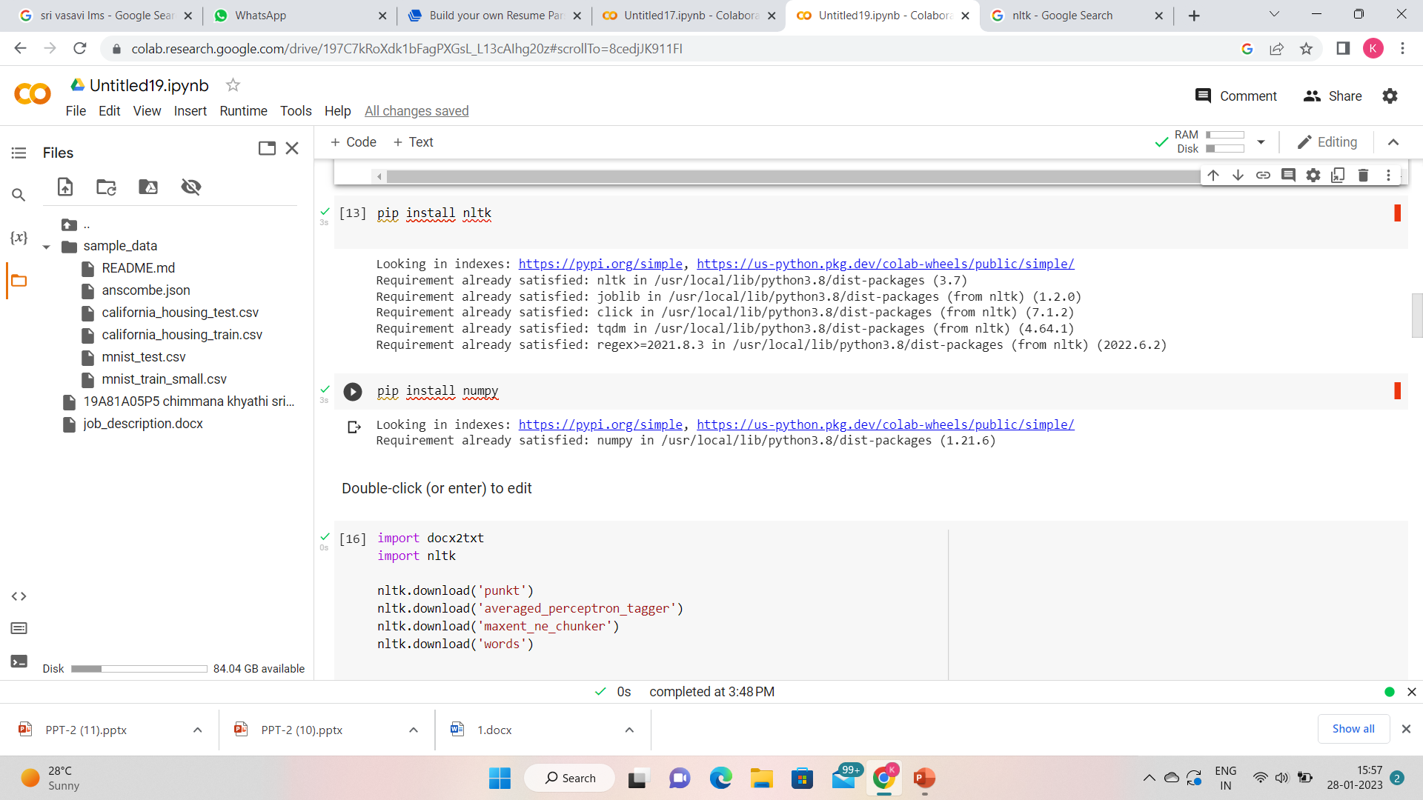
Step -4:-Installing nltk . It is a really powerful tool to preprocess text data for further analysis like with ML models for instance. It helps convert text into numbers, which the model can then easily work with

Slide 32
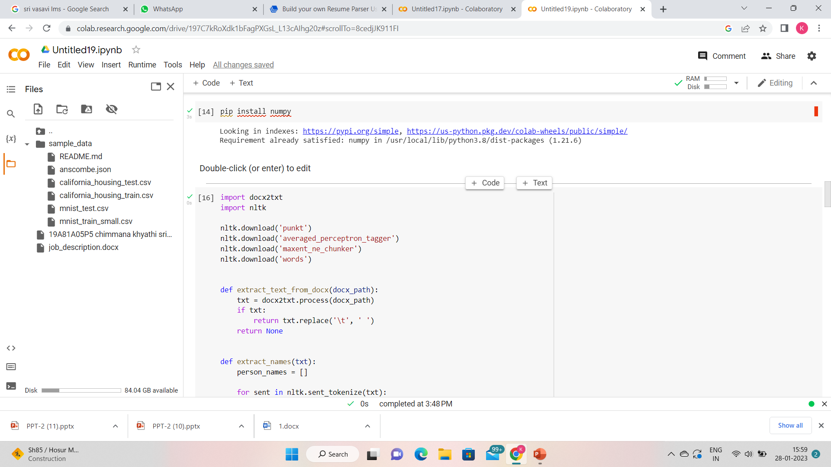
Step -5:-Installing NumPy. NumPy is a Python library used for working with arrays. It also has functions for working in domain of linear algebra, fourier transform, and matrices.

Slide 33
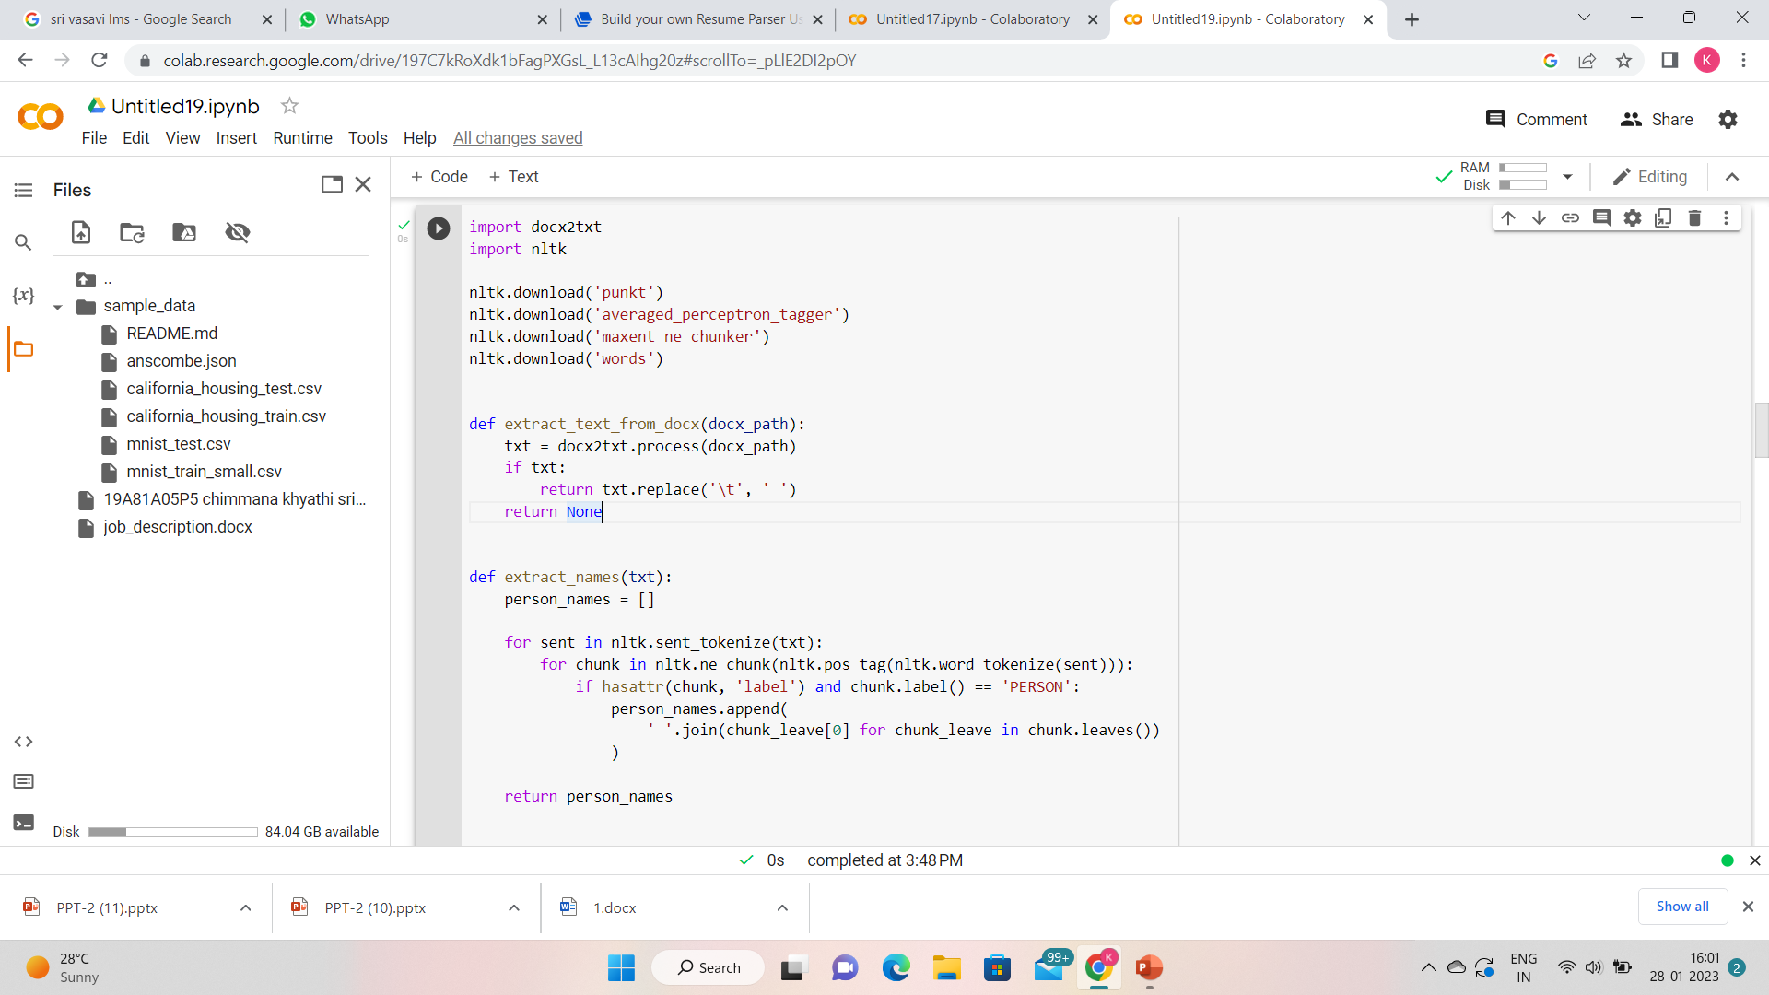
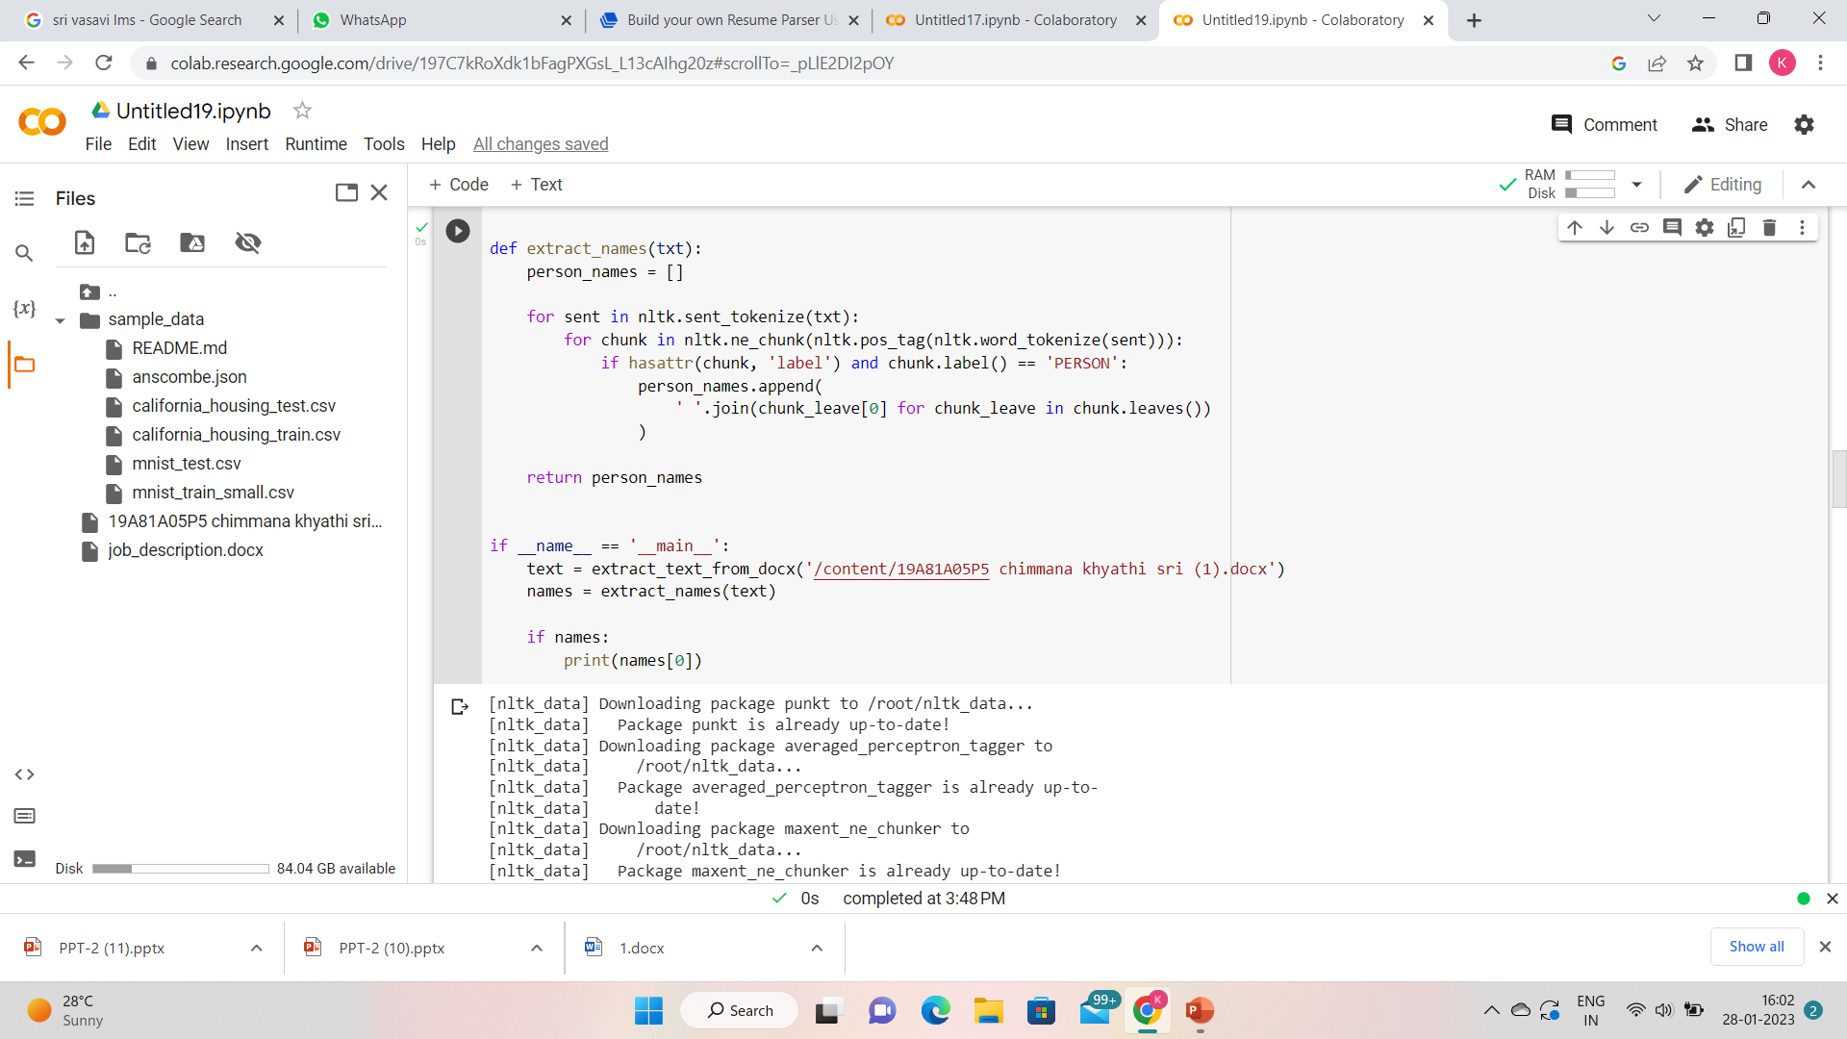
Step 6:-Extracting Names from resumes

Slide 34
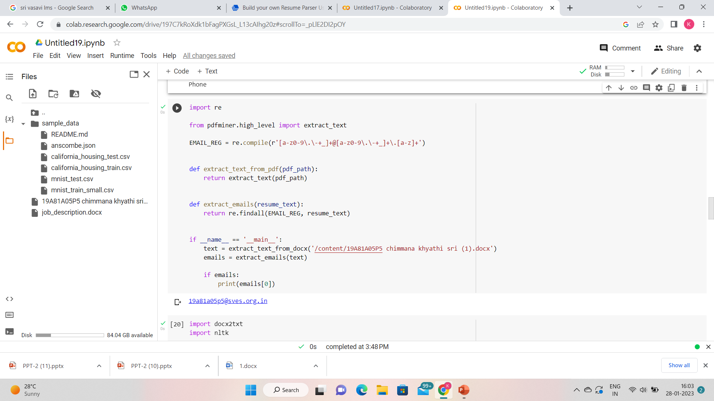
Step -7:-Extracting Email addresses

Slide 35
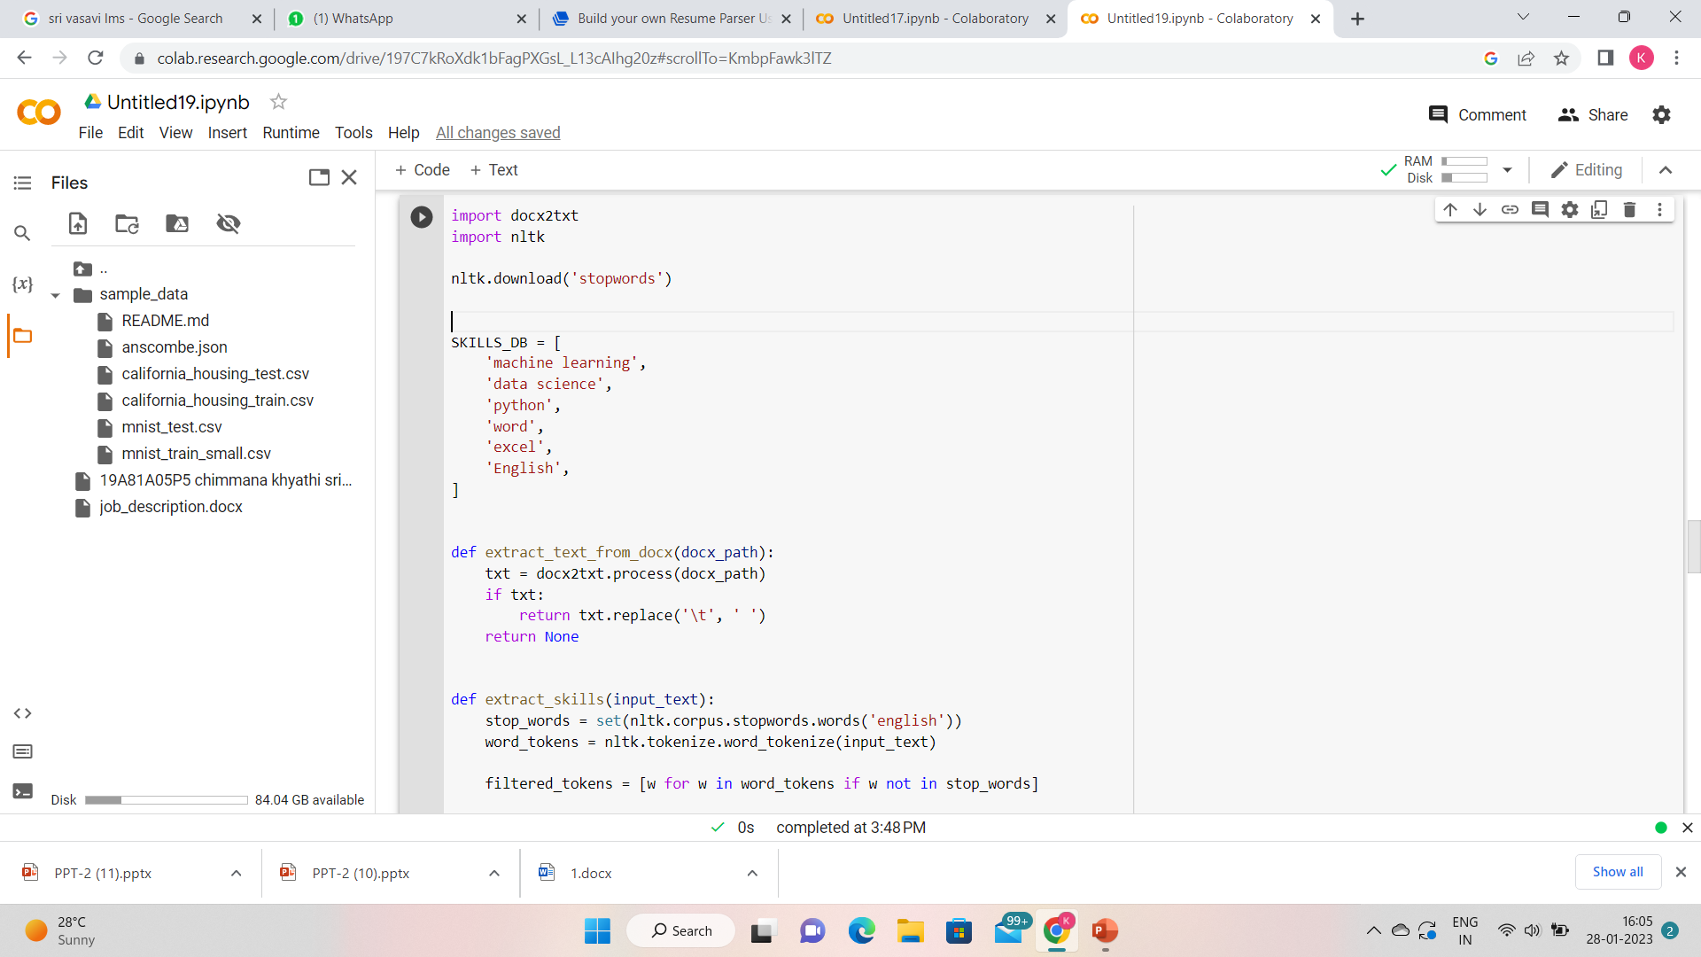
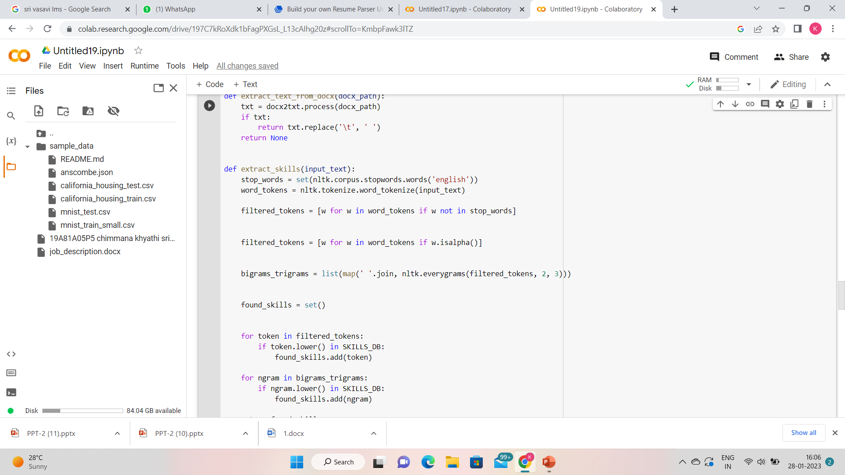
Step 8:-Specifying the skills and extracting those skills

Slide 36
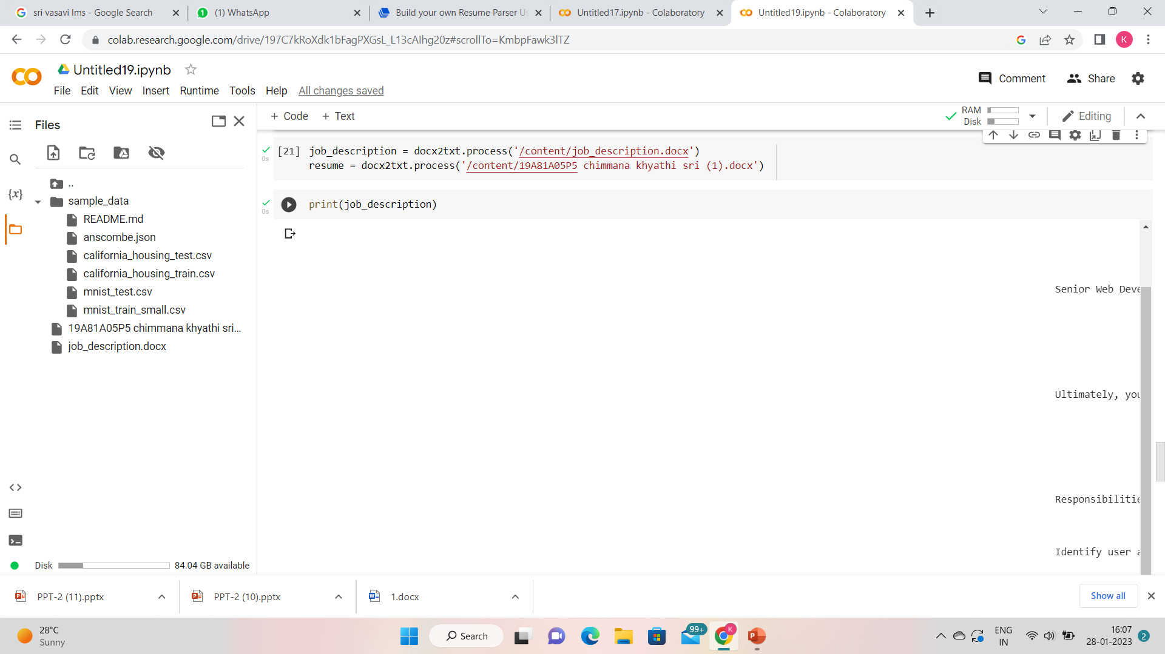
Step -9:-In this step we have to take the job description , we have to specify the set of requirements like the title,educational qualifications,certifications,Experience,Skills,languages known.
Running docx2txt. process will extract any images in the Word Document and save them into this specified folder.
In the next step , we have to specify resume which is going to be parsed with the specified job description.

Slide 37
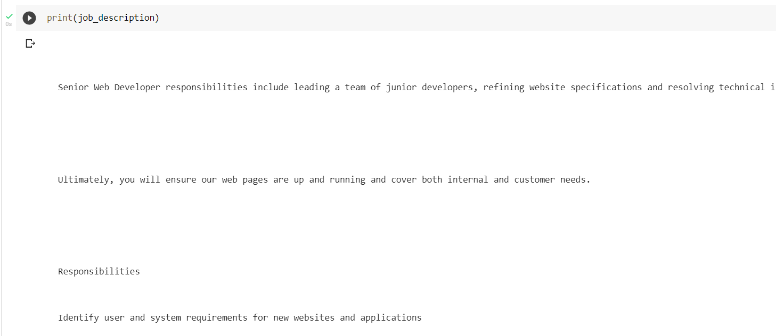
Step 10:-In this step, we have printed the entire job description

Slide 38
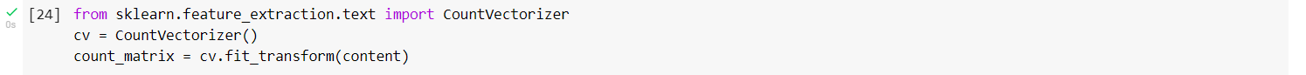
Step 11:-sklearn.feature_extraction.text, is used to Convert a collection of text documents to a matrix of token counts.This implementation produces a sparse representation of the counts using scipy.sparse.csr_matrix.If you do not provide an a-priori dictionary and you do not use an analyzer that does some kind of feature selection then the number of features will be equal to the vocabulary size found by analyzing the data.

Slide 39
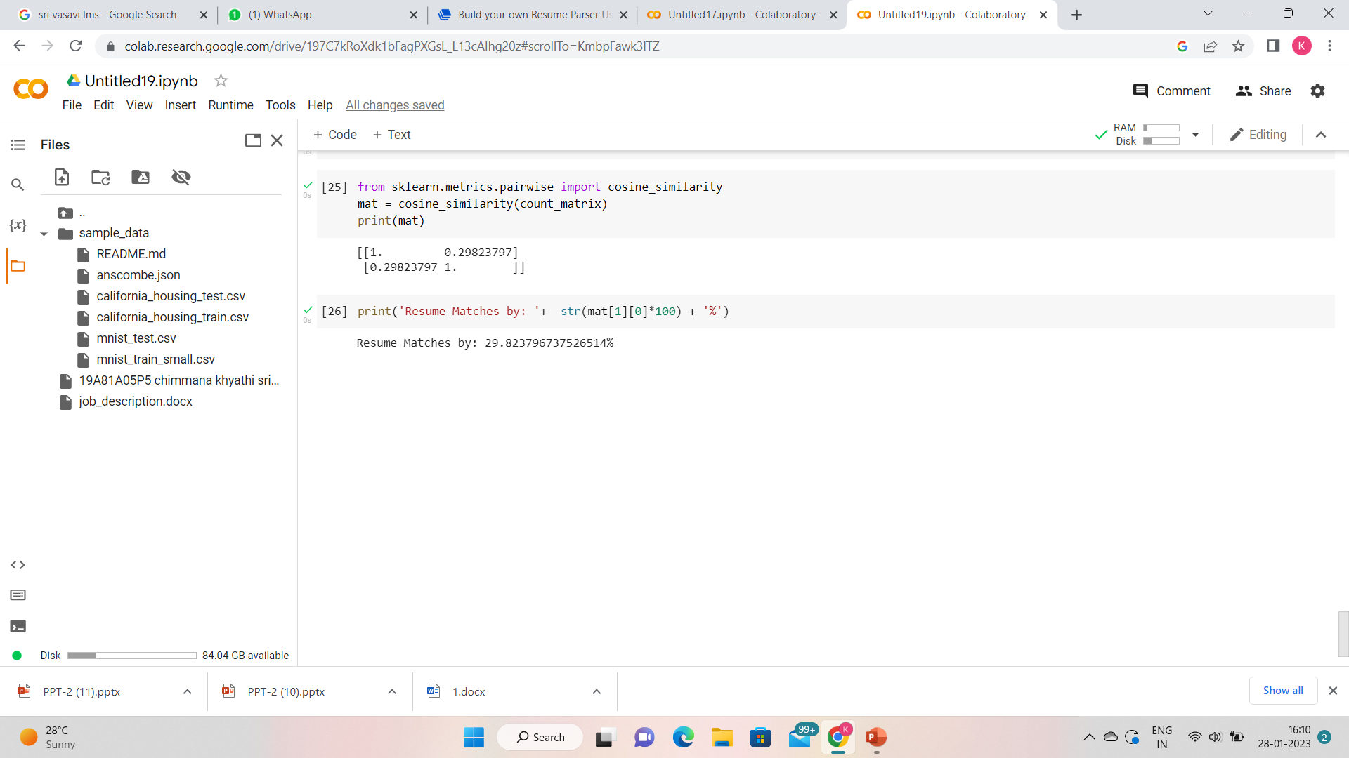
Step 12:-Compute cosine similarity between x and y.Cosine similarity ,or the cosine kernel,computes similarity as thenormalizied dot product of x and y.

Slide 40
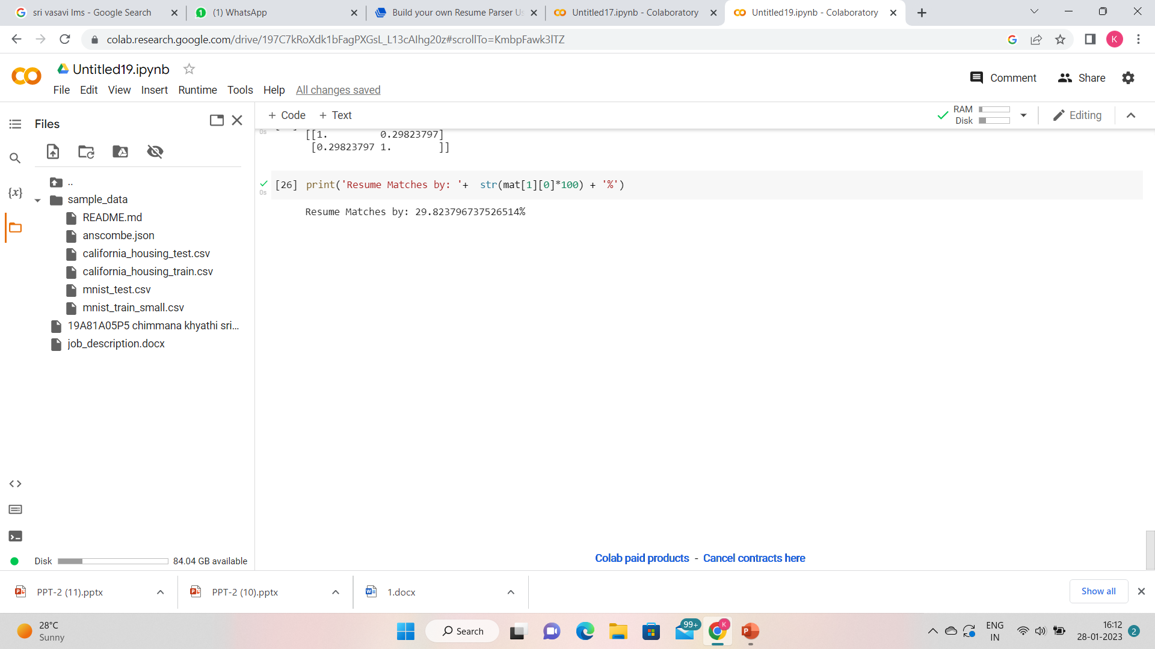
Result Analysis:-
Comaprision of given resume with no front end skills is compared with the job description,the resulted outputted percentage was ,

Slide 41
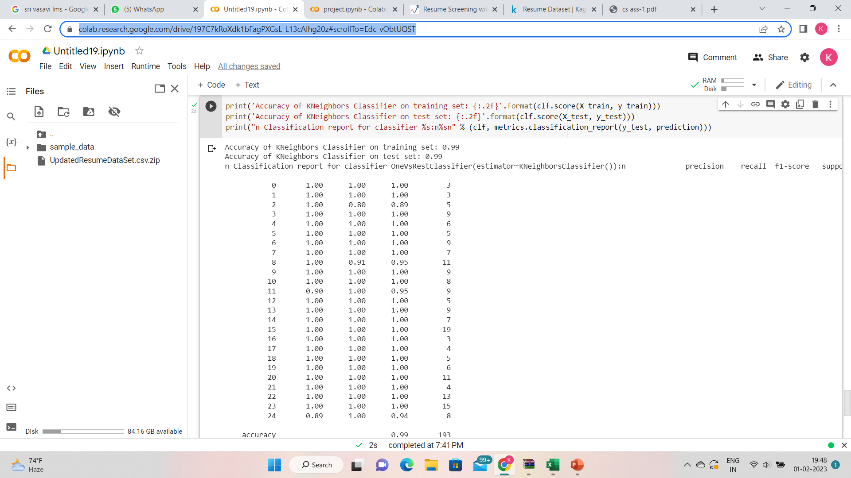
Comparing various resumes
Inorder to classify several resumes, we used a machine learning approach called KNN(K Nearest Neighbour).

Slide 42
Attainment of objective
In this project we have attained the percentage of the match with job description using NLP .Parsing the resume is gives the exact requirements that a company need.It helps in reducing the amount of time required.

Slide 43
Future scope of project:-
It is better to use another more machine learning algorithms , and compare their accuracies.By comparing each ,we come to know which is the best in parsing the resumes.

Slide 44
Project plan:
Project part | Time
Literature Survey | 2 weeks
Problems in Existing systems & Proposed System | 1 week
System Architecture | 2 weeks
Objective | 2 weeks
Methodology & Design | 2 weeks
Functional & Non Functional Requirements | 1 week
Implementation and Result Analysis | 5 weeks

Slide 45


